Slide 1
Semaphore

Slide 2
Agenda
What is a semaphore?
Semaphore functions
Semaphore problem1
Producer – Consumer problem
Solution
What if?
Thanks

Slide 3
What is a semaphore
In programming, semaphores are a technique for coordinating or synchronizing activities in which multiple processes compete for the same operating system resources. A semaphore is a value in a designated place in operating system (or kernel) storage that each process can check and then change. Depending on the value that is found, the process can use the resource or will find that it is already in use and must wait for some period before trying again. Semaphores can be binary (0 or 1) or can have additional values. Typically, a process using semaphores checks the value and then, if it using the resource, changes the value to reflect this so that subsequent semaphore users will know to wait

Slide 4
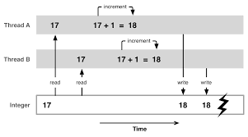
What is a semaphore
In brief Shared resources

Slide 5
Semaphore in code
#include<semaphore.h>
Semaphore functions
sem_init(&sem_name, 0, 10);
sem_wait(&sem_name);
sem_post(&sem_name);

Slide 6
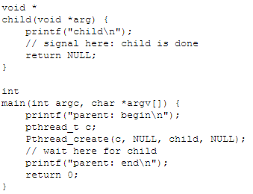
Problem 1 parent - child

Slide 7
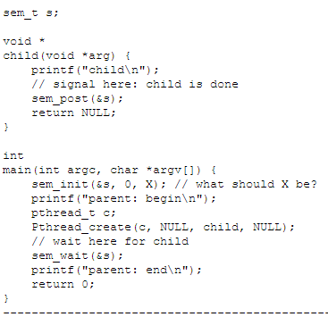
Parent – child (cont)

Slide 8
Output
parent: begin
Child
parent: end

Slide 9
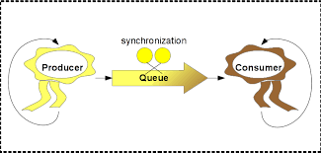
Producer – Consumer problem

Slide 10

Solution (semaphore)
Think

Slide 11
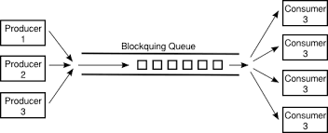
What if?
There are more producer & consumer

Slide 12

problems
Deadlock

Slide 13

Deadlock Solution
Next Lab

